Slide 1
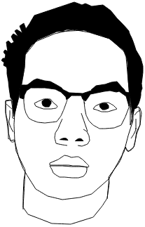
MUHAMMAD AQIL ZIKRY BIN MOHD NIZAM
MY PORTFOLIO
These are all projects
I’ve worked on/I was involved in
Hi I am,

Slide 2

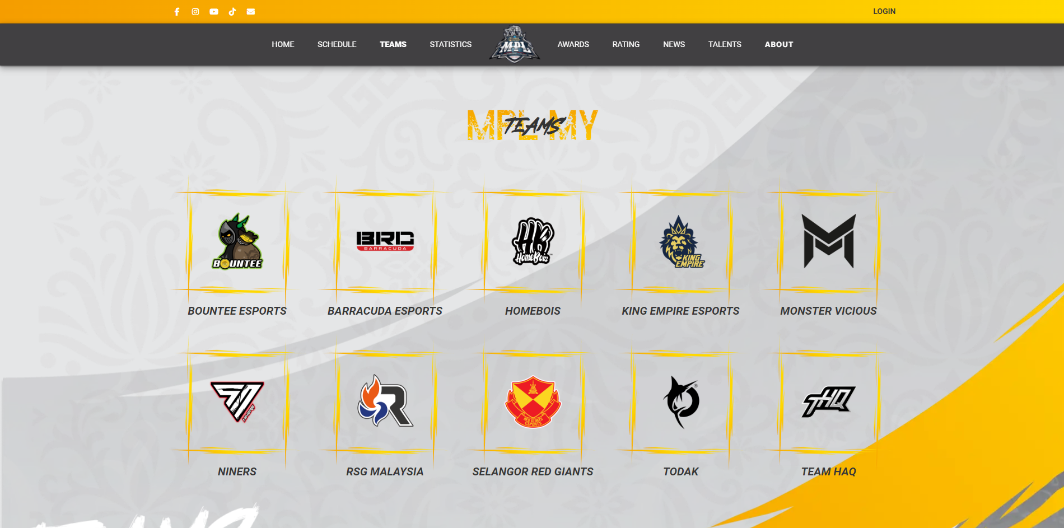
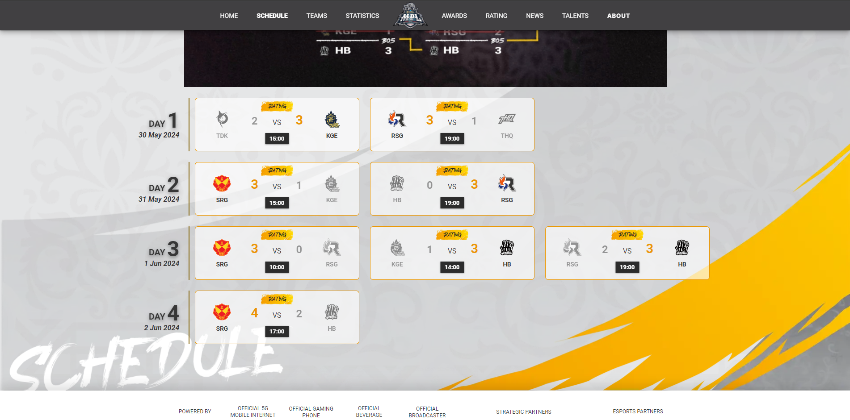
internship
GOOGLE EXCEL . ELEMENTOR . CSS . HTML . WORDPRESS
https://my.mpl.mobilelegends.com
Was tasked to insert and design team schedules
Used google sheets online to link with the website about the players statistics and schedule
Home page touch-ups and ideas
MPL MALAYSIA

Slide 3
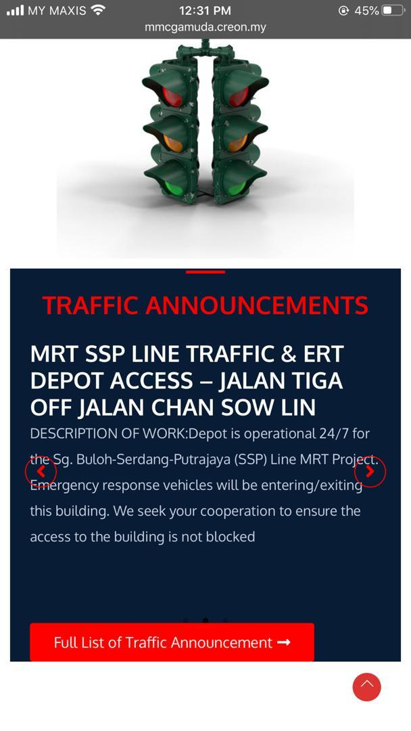
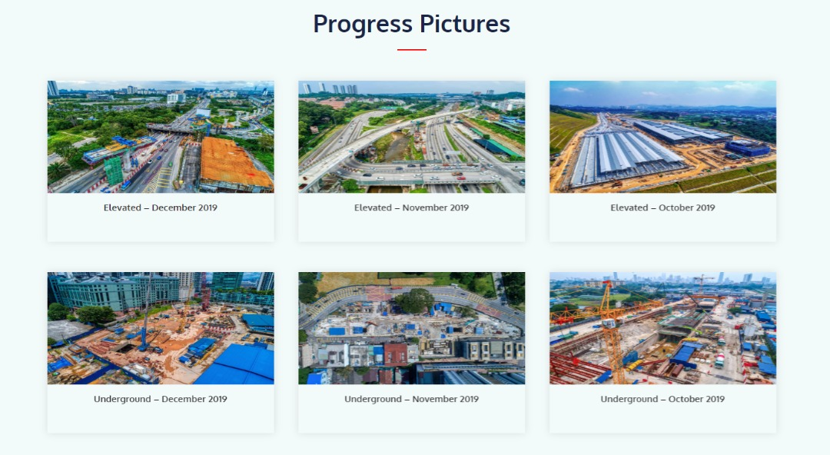
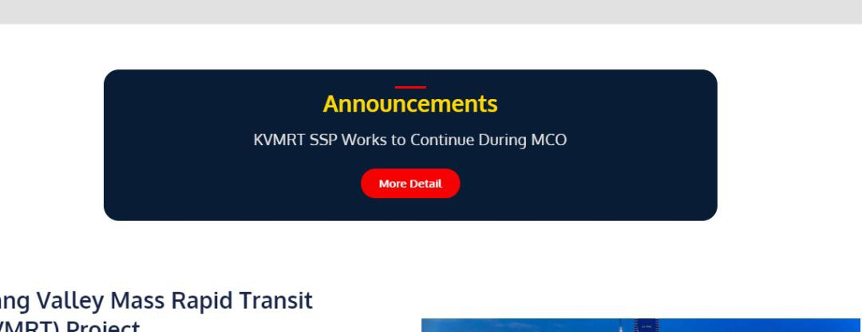
internship
ELEMENTOR . CSS . HTML . WORDPRESS
https://mmcgamudamrt.com.my/
(Down Currently)
Responsible on updating progress pictures sent from client
Designed and made the progress picture page
Update announcements and mobile view of the site
MMC GAMUDA

Slide 4
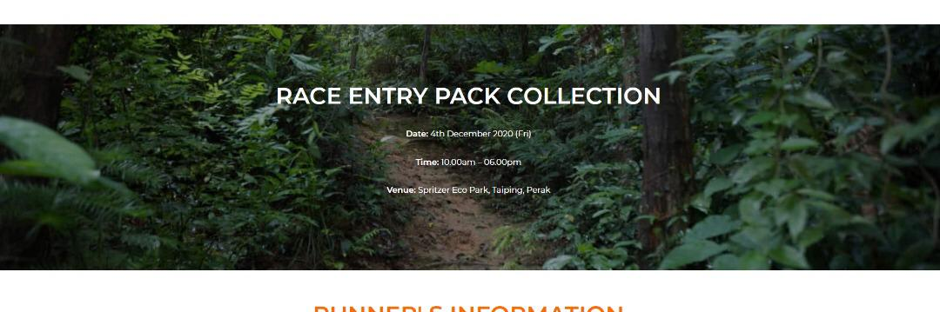
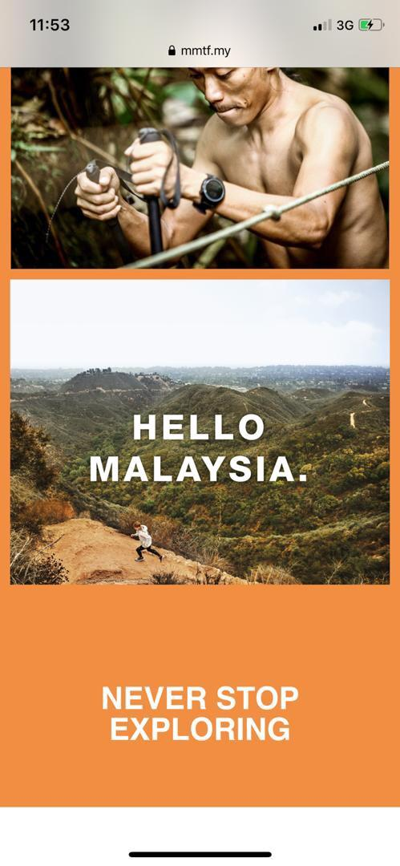
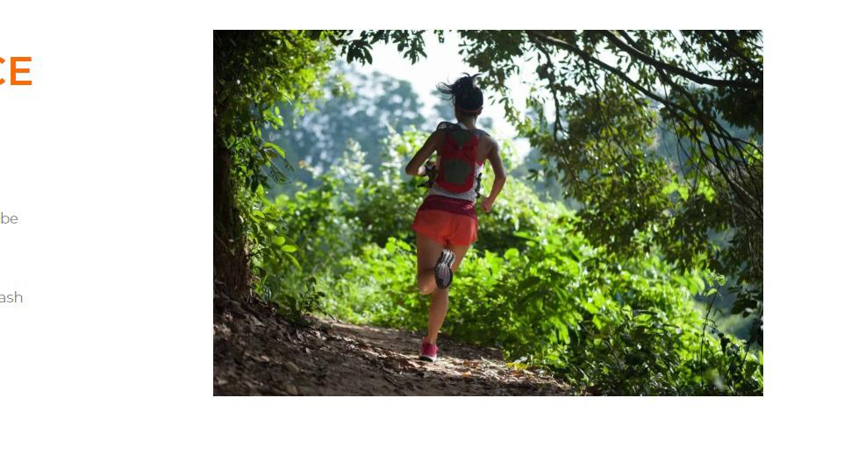
internship
ELEMENTOR . CSS . HTML . WORDPRESS
https://mmtf.my/
Redesigned the mobile view of the website to fit viewers preference
Resized using photoshop most of the pictures on the website to fit viewers preferences
Updated the info on the website according to the client needs
THE NORTH FACE

Slide 5
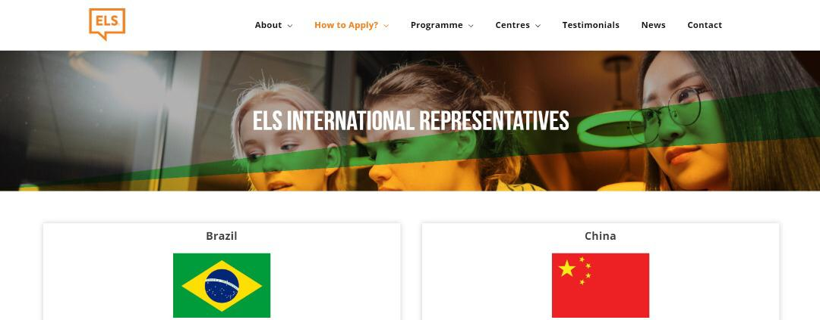
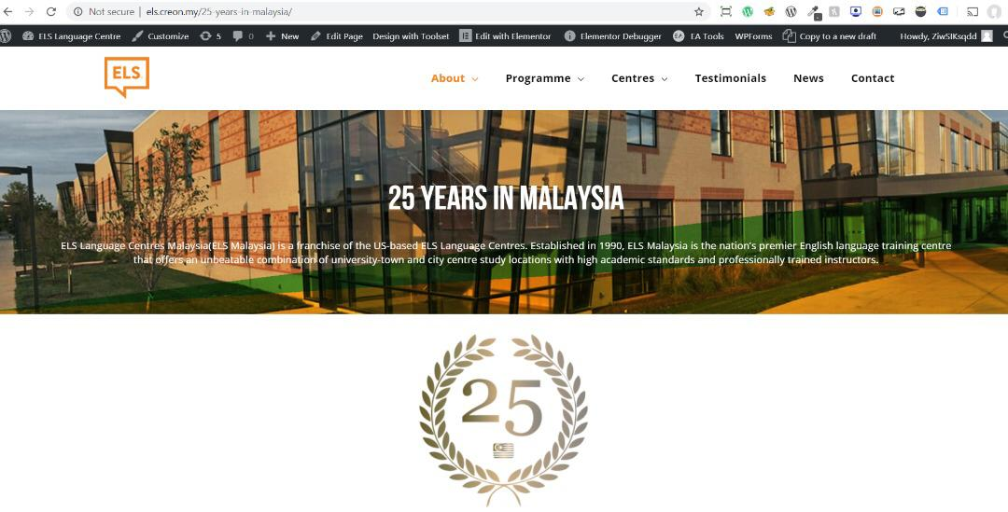
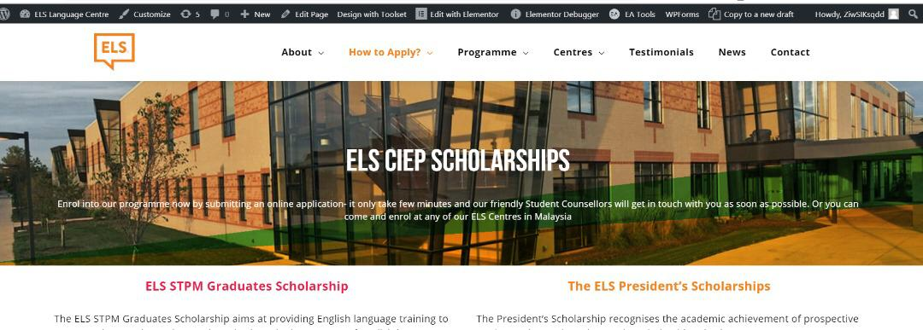
internship
JAVASCRIPT . ELEMENTOR . CSS . HTML . WORDPRESS
https://www.els.edu/
Fix a bug of code for price of courses that would effect price calculation
Created ELS Ciep scholarships page
Few alignments made for website pages
ELS LANGUAGE CENTRE

Slide 6

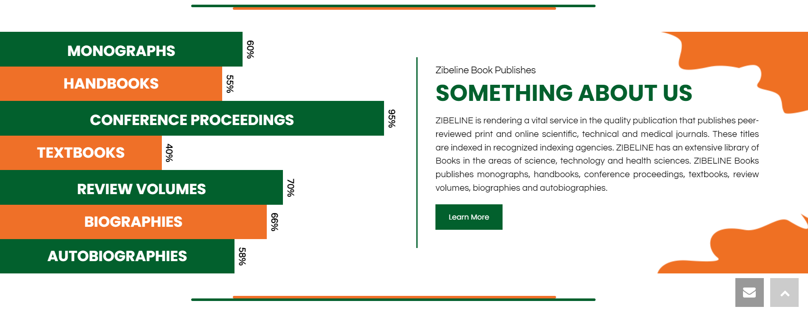
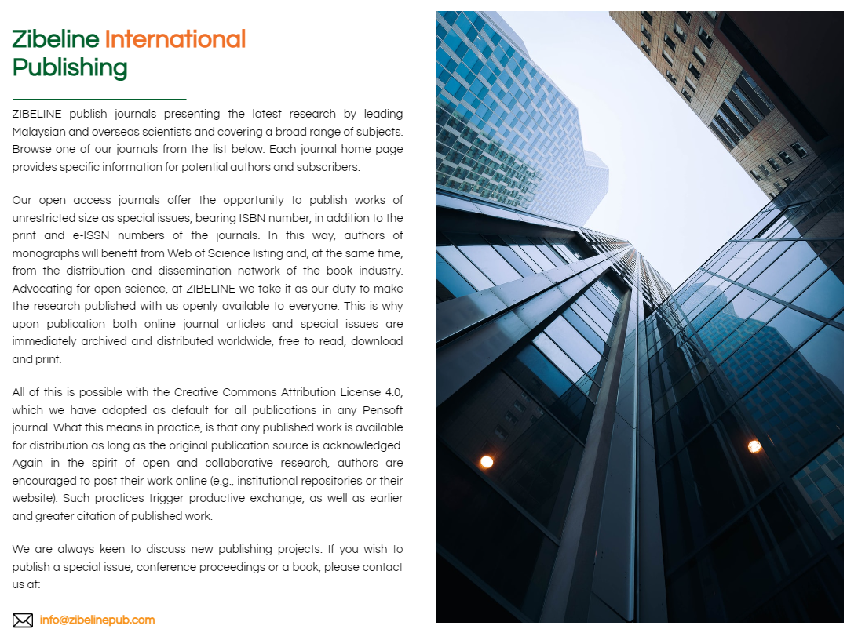
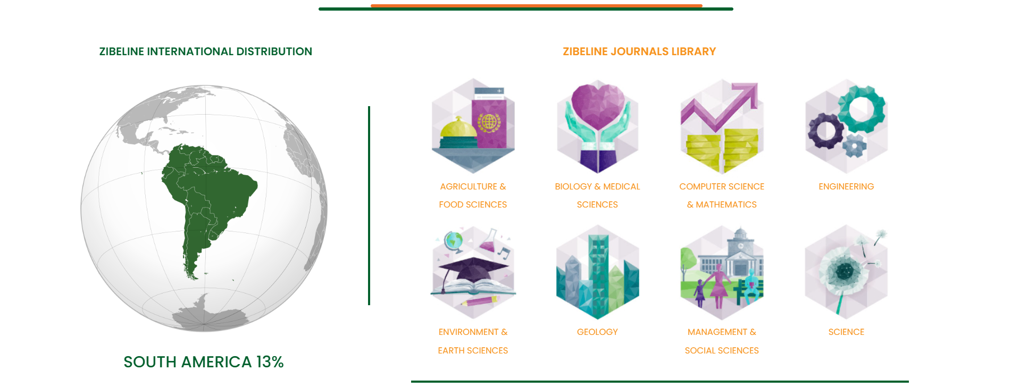
junior web developer
JAVASCRIPT . ELEMENTOR . CSS . HTML . WORDPRESS
https://www.zibelinepub.com/
Hugely modernized the main page of the company website
Made it as colourful according to the logo colour’s
ZIBELINE INTERNATIONAL PUBLISHING

Slide 7
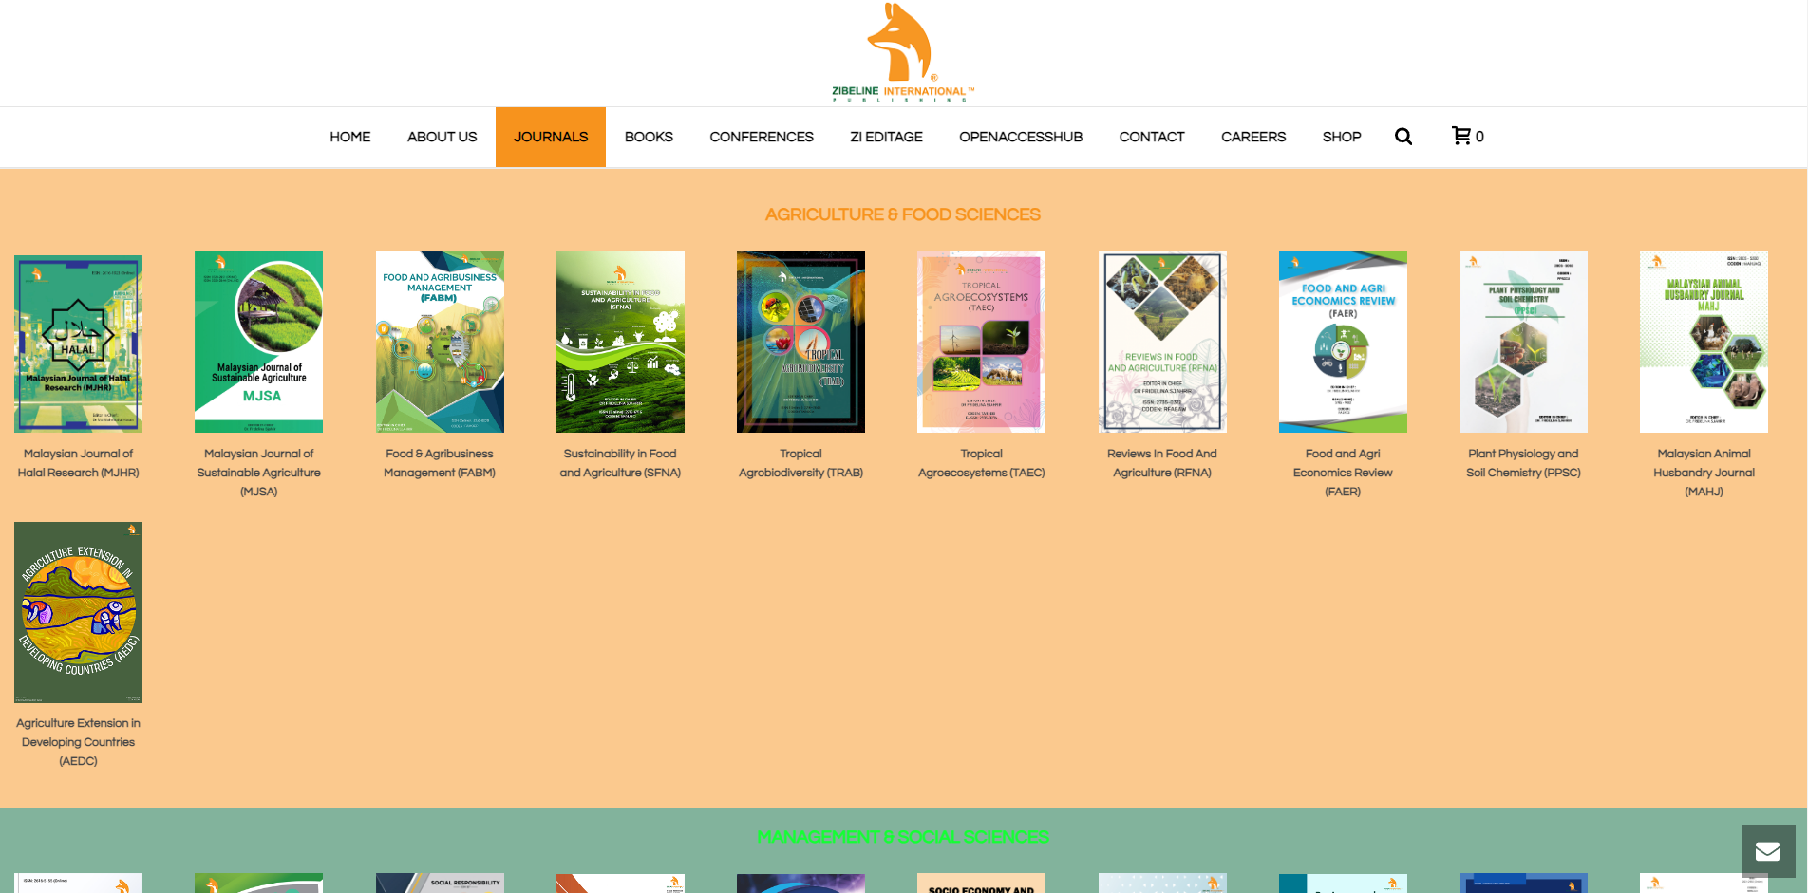
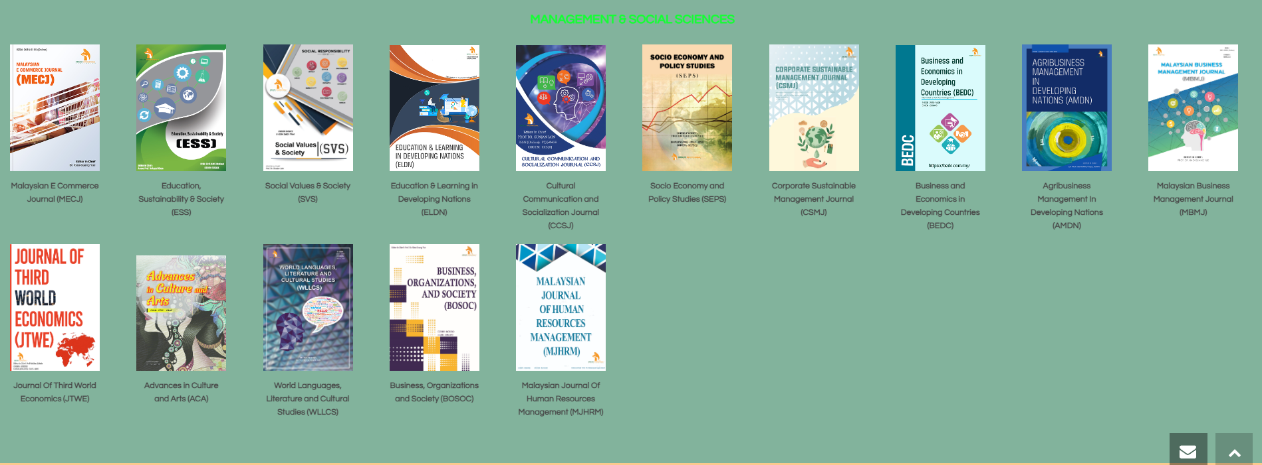
junior web developer
ELEMENTOR . CSS . HTML . WORDPRESS
https://www.zibelinepub.com/journals/
Handled all the wordpress site on the company’s website
Made sure every website was online and working as per usual
Each journals is their own website (Wordpress)
ZIBELINE INTERNATIONAL PUBLISHING

Slide 8
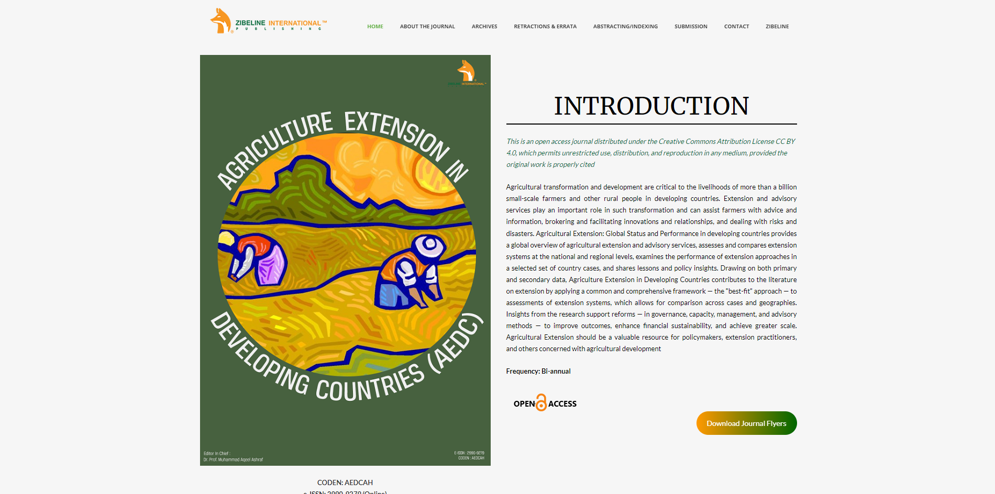
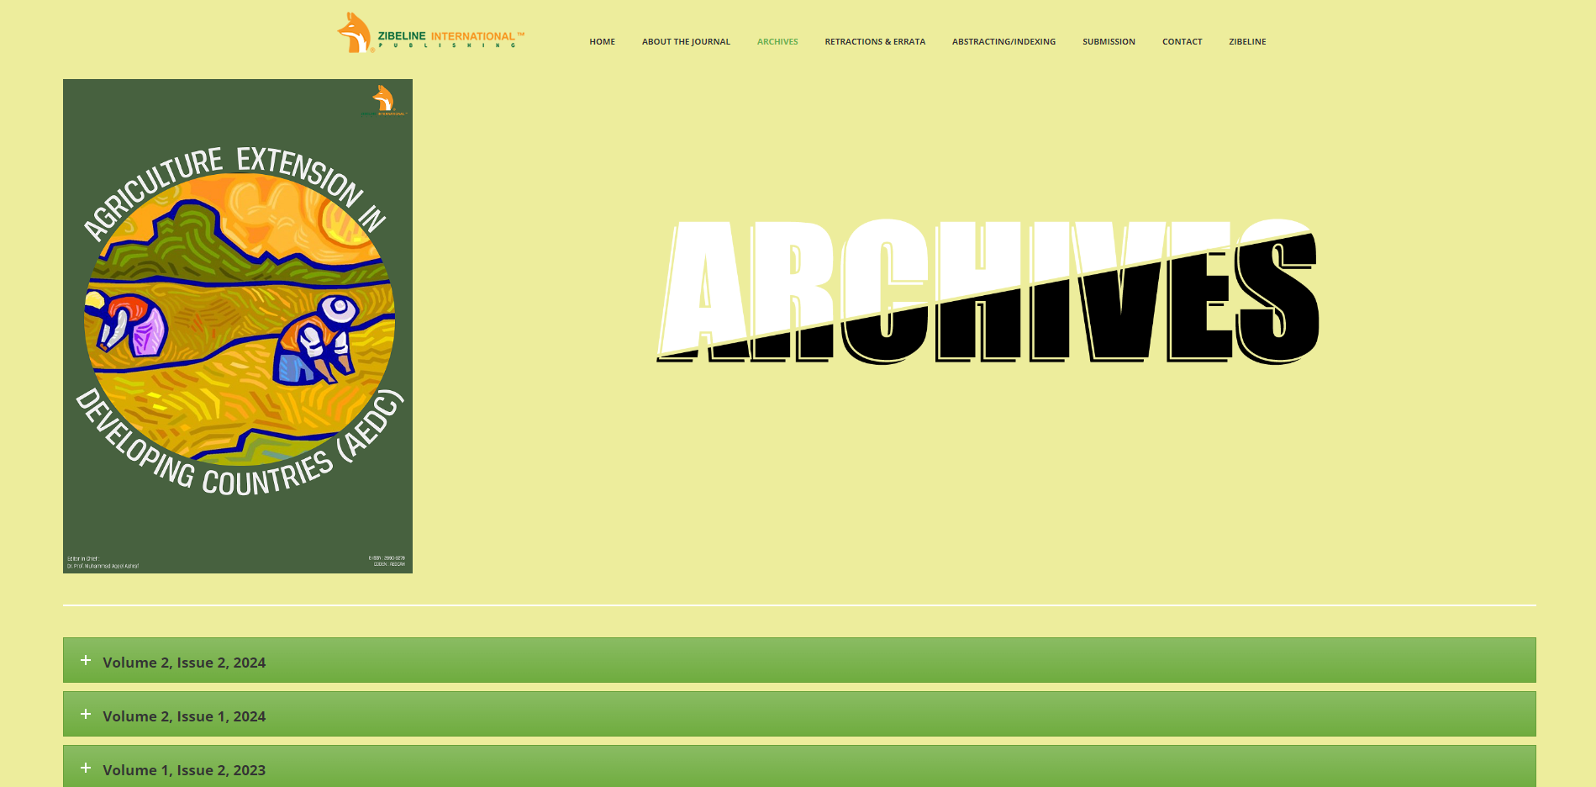

junior web developer
PHOTOSHOP . ELEMENTOR . CSS . HTML . WORDPRESS
https://aedc.com.my/
Also made the cover for the journal
One of the example journal website that was made by me
Made a journal website design as requested by employer
AGRICULTURE EXTENSION IN DEVELOPING COUNTRIES (AEDC)

Slide 9
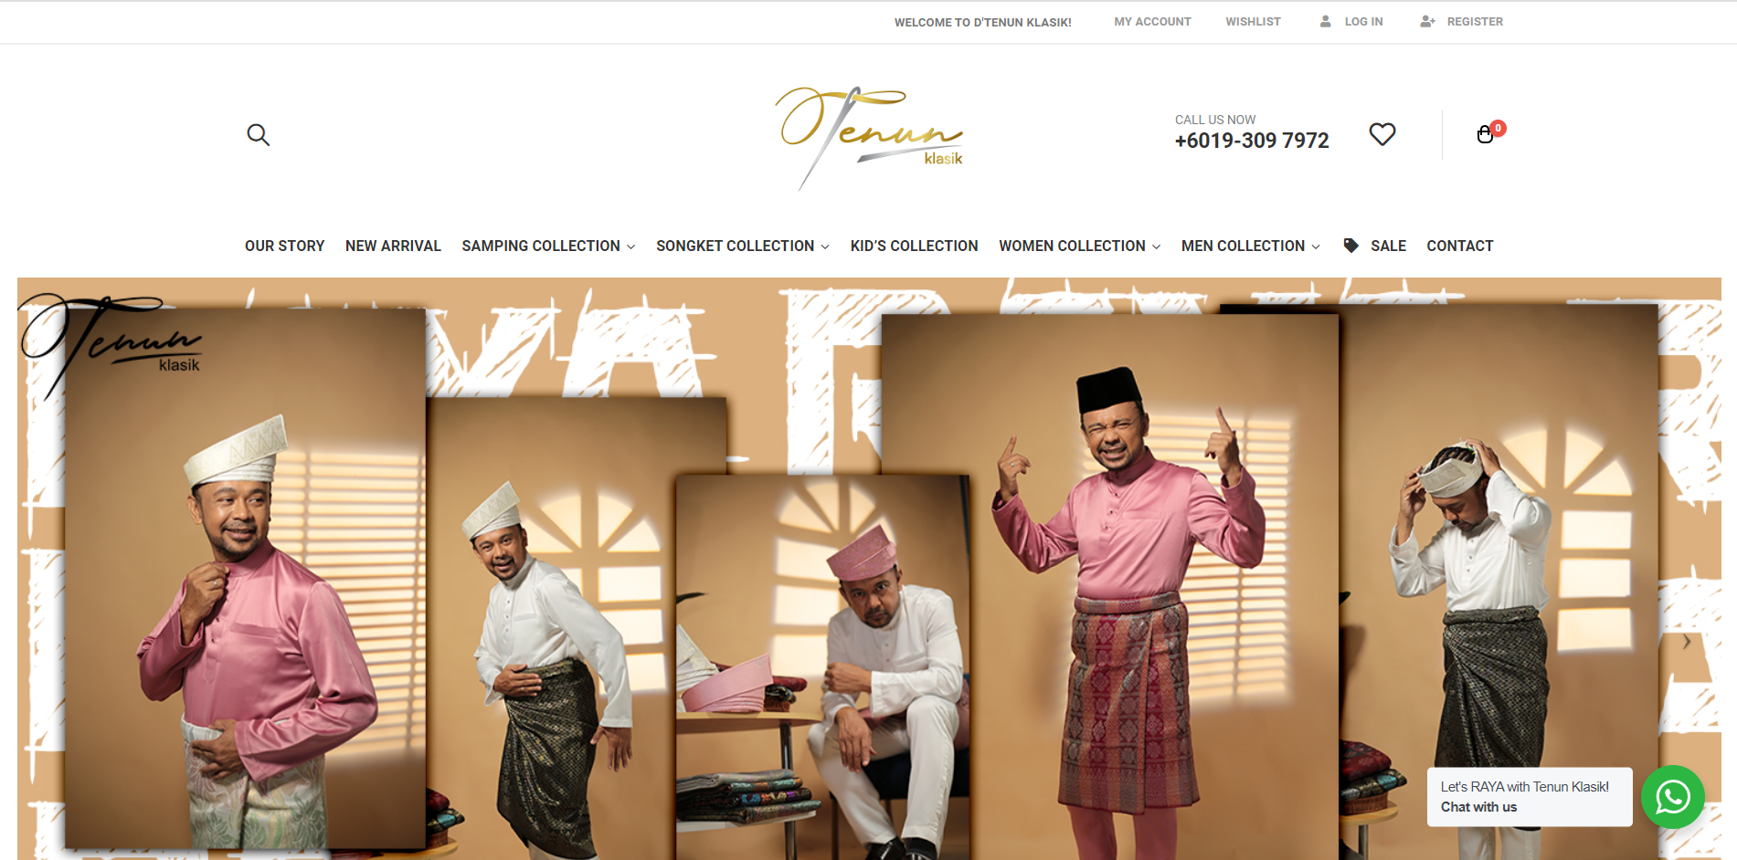
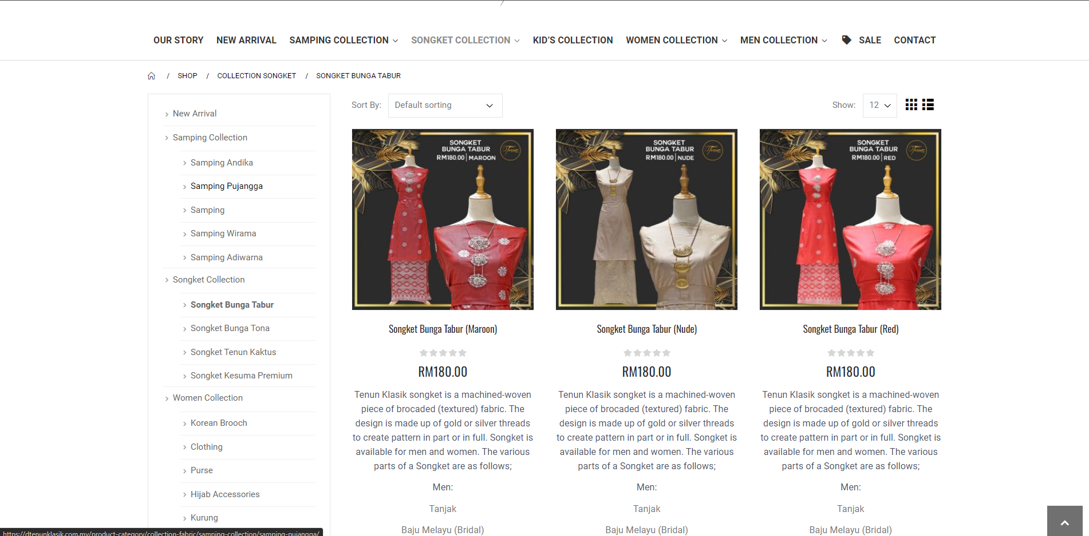
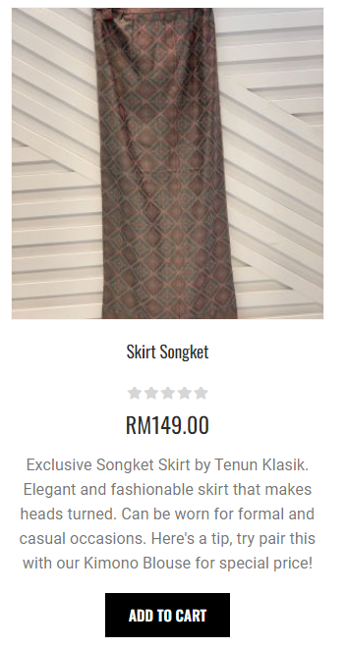
junior web developer
WOOCOMMERCE . PHOTOSHOP . CSS . HTML . WORDPRESS
https://dtenunklasik.com.my/
Made graphics for the website using Adobe Photoshop/ Adobe Illustrator
Used WOO Commerce for the website e-commerce system
Made adjustments to the product interface so that the description of the product is readable and easier for the customer
D’TENUN KLASIK

Slide 10
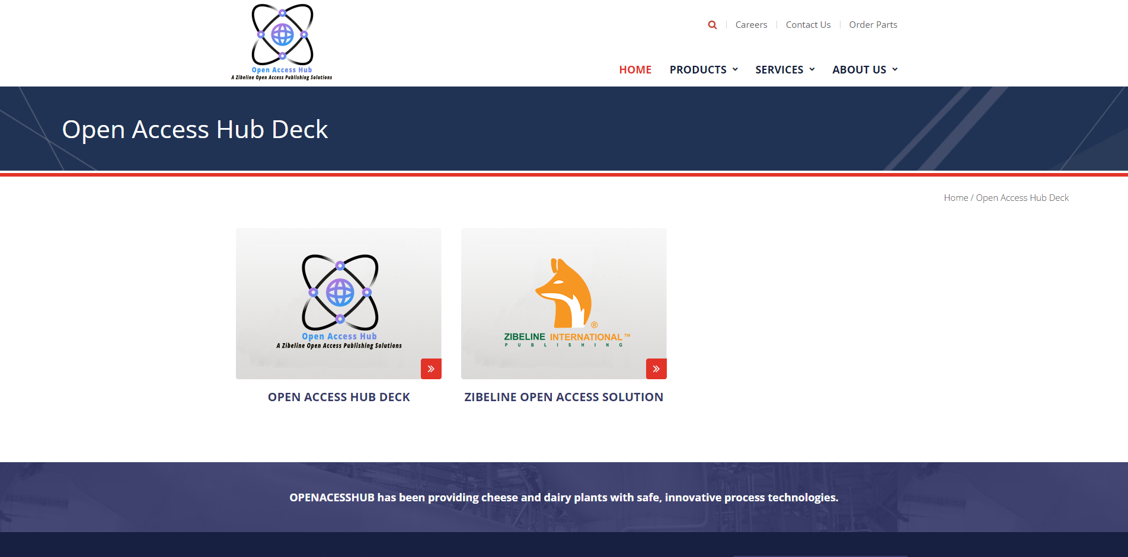

junior web developer
WOOCOMMERCE . PHOTOSHOP . CSS . HTML . WORDPRESS
https://openaccesshub.my/
Made the website from scratch according to the example given by the employer
OPEN ACCESSHUB

Slide 11
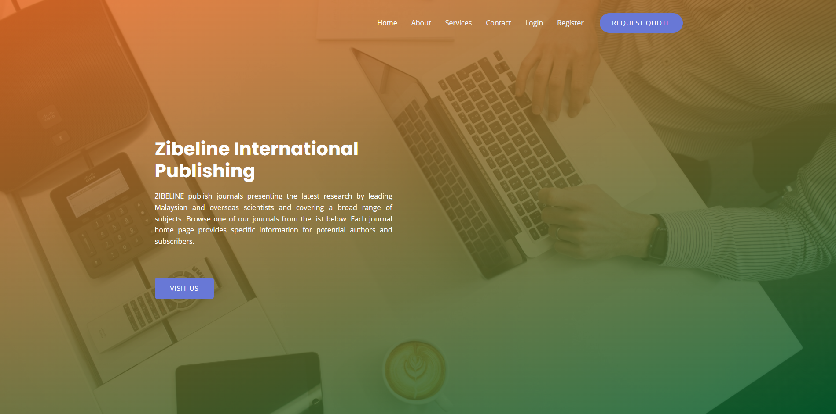

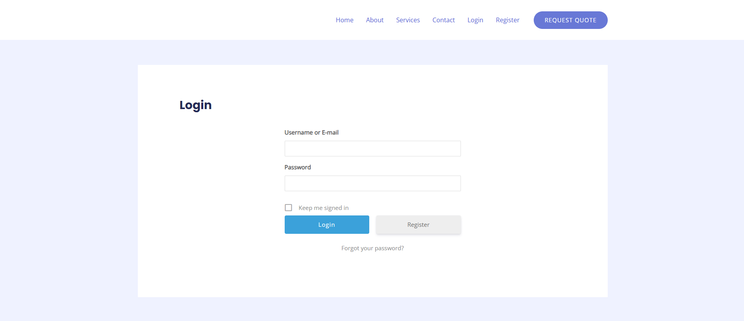
junior web developer
CSS . HTML . WORDPRESS . ELEMENTOR
https://zibelinesubmissions.com/
(Ongoing Still)
Created a website from scratch for users that would be to upload their thesis into our journals
A form login system that requires user to login to upload files
ZIBELINE SUBMISSIONS

